Slide 1
Preparing a Philatelic Display or Exhibit
An introduction to some of the concepts and practicalities
Covering both competitive exhibits and non-competitive displays, club presentations

Slide 2
Topics
What is an Exhibit?
Practicalities - exhibition frames
Organising your material
Writing up your Display
Preparing a Title or Introductory page
More Practicalities

Slide 3
What is an Exhibit or Display?
A presentation of material to an audience including
· designing the layout so it is easy to follow and attractive to the eye
· organising the material in a logical way
with a view to explaining what is on the pages to a viewer who does not know the material.

Slide 4
Practicalities - Exhibition Frames
Your pages need to fit the standard Australian frames
Display 16 standard sheets in 4 rows of 4, or equivalent in larger paper sizes.
The sheets are held in place by clear strips and a clear sheet of perspex covers the whole display
Max paper height is 283 mm – A4 (297mm) is too tall to fit the frames (TPS display frames are not suitable for A4 either)
Each sheet needs a clear protector – a clear envelope slightly larger than the sheet closed on 3 sides

Slide 5
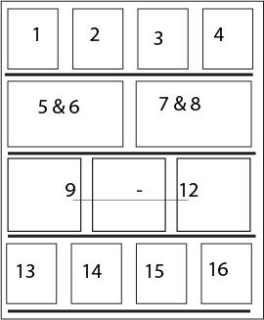

Slide 6
Organising your Material
What is your scope?
What is your story ?
What it the beginning and end point
Chronological?
Geographical?
According some a timeline of an event?
Selecting material – What is important to your story? Best condition available. Rarer items might not be in good condition but the only examples available.
Pre-cursors? The end of the Story?

Slide 7
Develop a Plan
How will you organise your material? – e.g.
Simple chronological organisation – Stamps of the reign of King George VI – 1937 - 1952 (Traditional Class)
By stamp designer/engraver (Traditional class)
By stamp theme across countries eg Christmas Stamps, Coronation issues (Traditional, thematic class)
The story of a stamp from design (essays) to trials, proofs, printings and use (the purpose the stamp was created for) (Traditional)

Slide 8
Develop a Plan (2)
A classification EG (Topical Class)
Butterflies on stamps -taxonomy, Cars on stamps by make and model
Cats by breed
A geographical area –eg West Coast of Tasmania (Postcards, Postal History)
A visit - Towns North-South or South – North
By Ore Body
A mix of material types of material eg Stamps, ephemera, covers, postcards, stationery (Open Class) illustrating any subject
Postmarks – by Post Office, by Type (Postal History – Marcophily

Slide 9
Stories
1. About the material itself, or
2. About anything, the material illustrates the story
- EG, stamp issues, Postal Stationery
- EG Cats Cars, Butterflies, a place, an event. You need a story line PLUS descriptions of the material

Slide 10
The 1d Green Letterpress Stamps of South Australia
In the 1860s, South Aust converted its recess printed stamps to letter press, for cost reasons. In 1875, plates for the newly-design 1d were prepared by De La Rue.
Plan
De La Rue Proofs (P 2, 3)
The Issued Stamps
Perf 10 – line, Perf 11.5 12.5 and compounds (P 4 – 10)
Perf 10 - comb (P 11, 12)
Perf 15 - comb (P 12 – 13)
Perf 13 – comb (P 14 – 16)

Slide 11
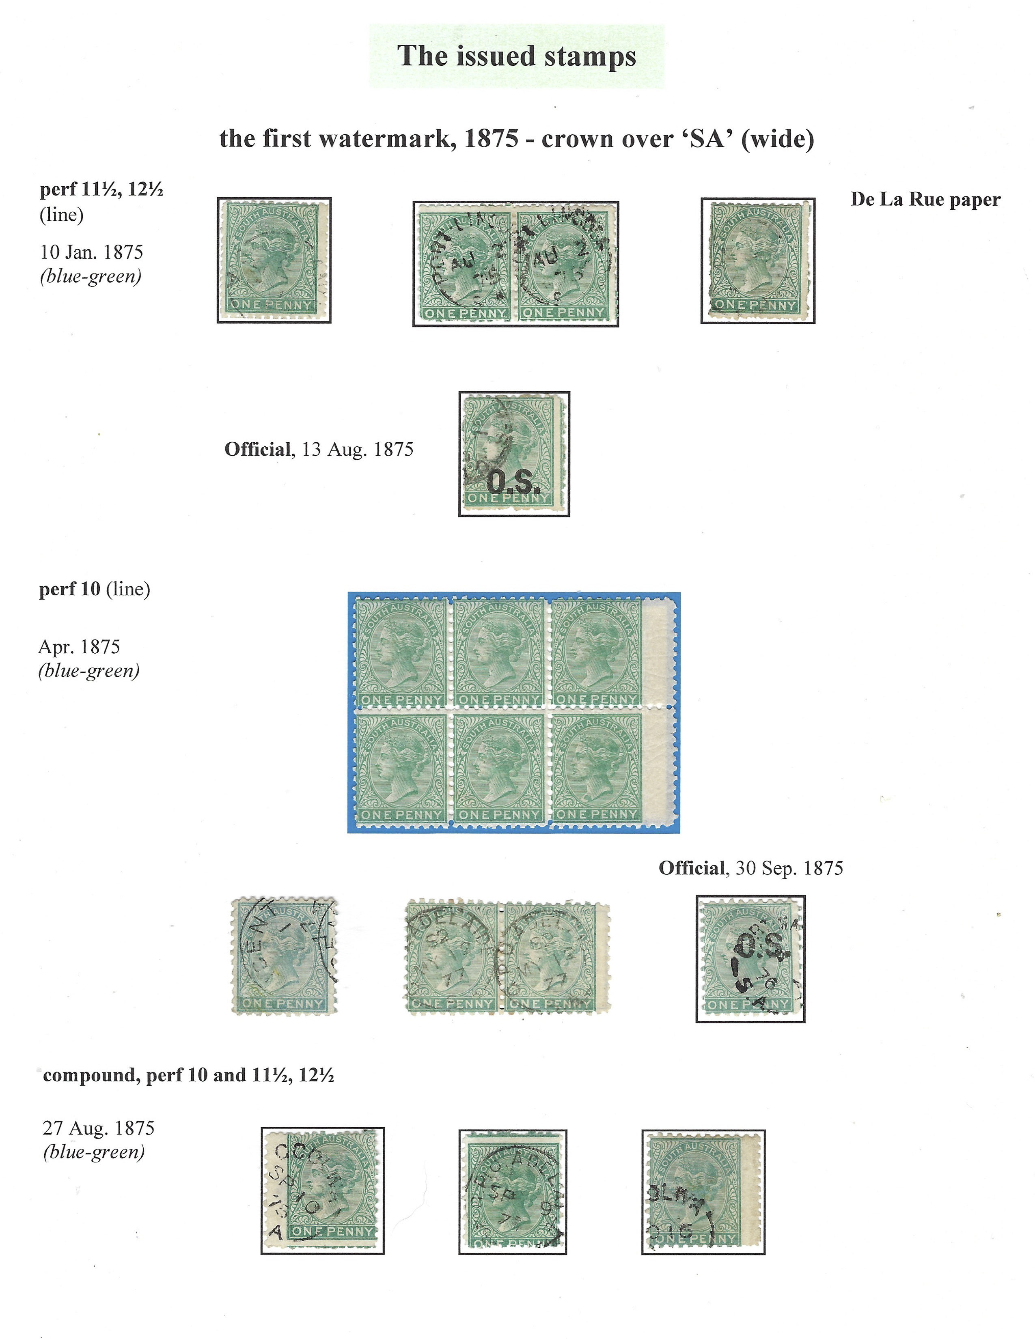

Slide 12
Napoleon: Exile, Death, Resurrection
Plan
The end of an era P 2-4
Captive on St Helena P 5 – 7
Death of Napoleon P 8 – 10
Burial – P 11
Resurrection P 12 – 14
Assassination or natural death P 15
Long Live the Emperor P 16
This Picture Postcard Exhibit tells the story of Napoleon Bonapart at the end of his life through Picture Postcards published by a variety of publishers and producers

Slide 13
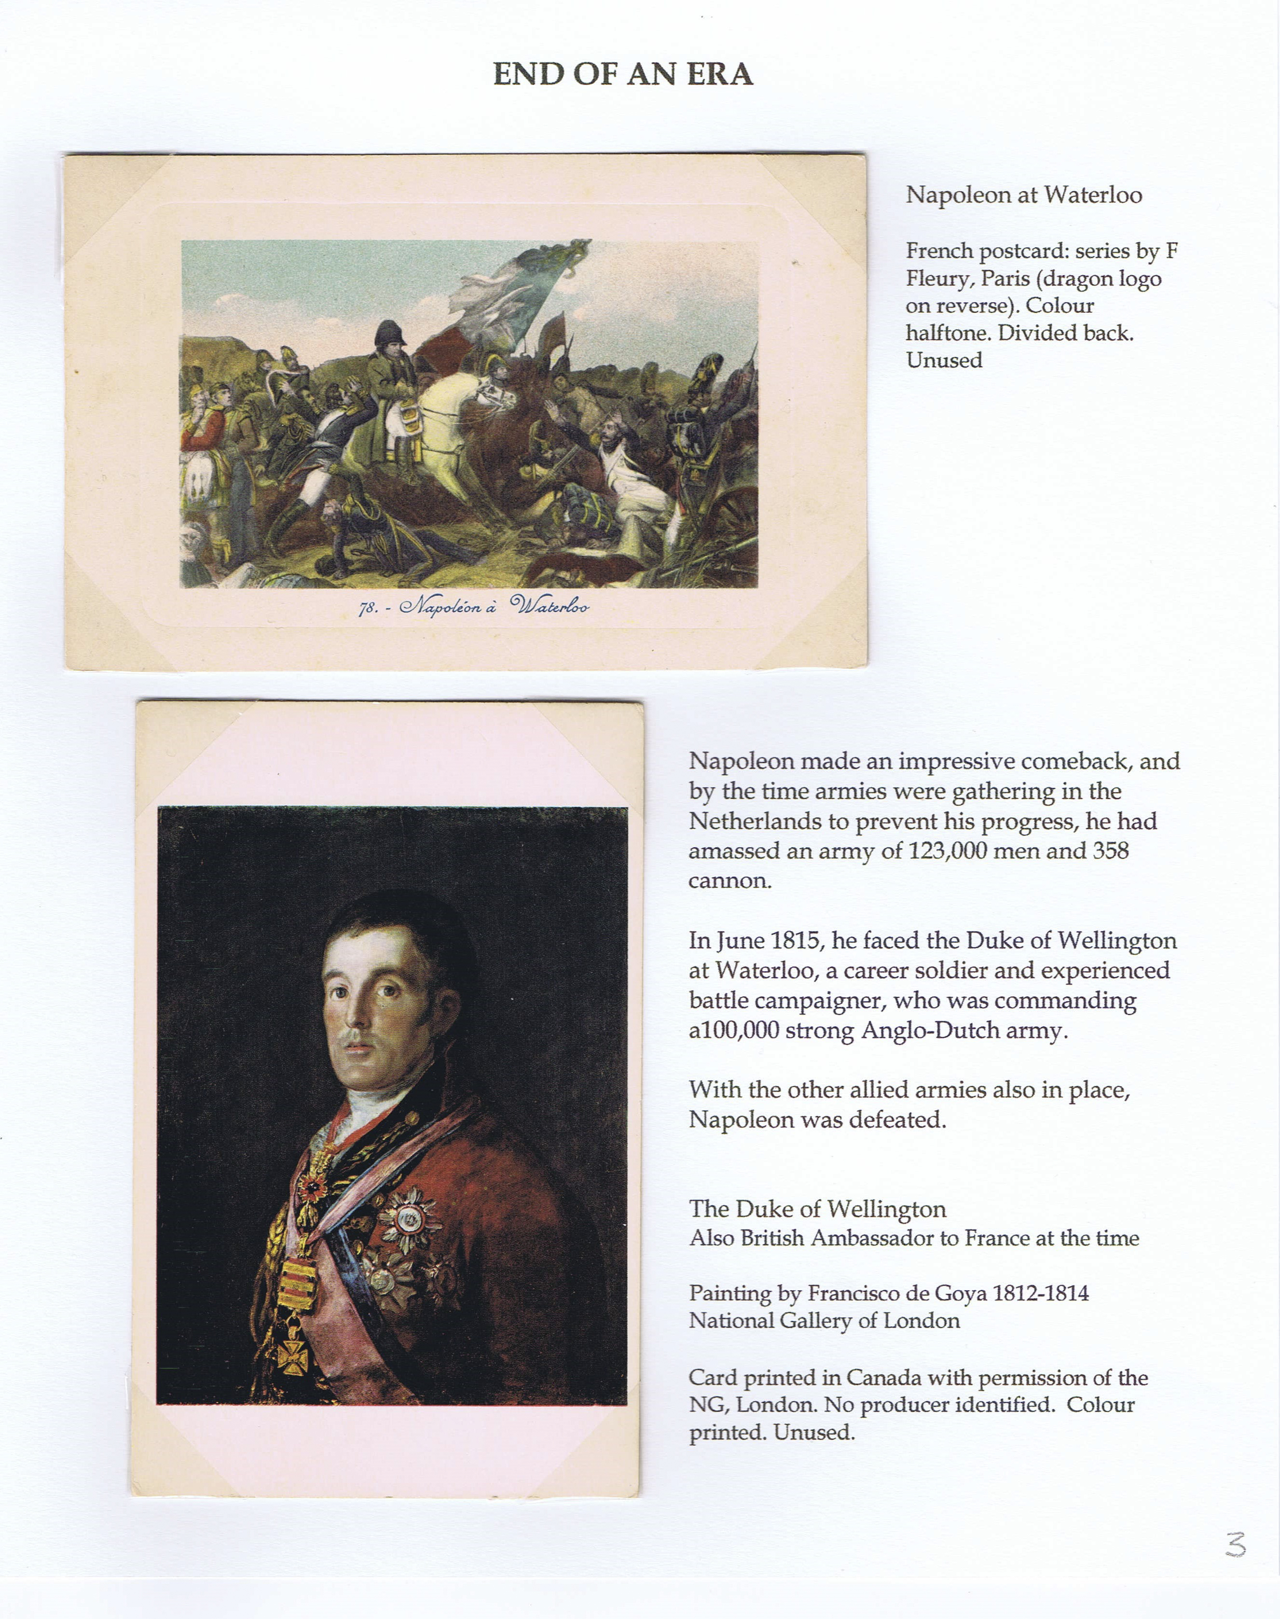

Slide 14
Designing Page Layouts
Margins (10mm all round for most printers)
Try to fit as much RELEVANT material on the page as possible without crowding
Importance of headings and sub headings,
Importance of white space but not too much. Balance of items on the page
Alignment – use of guide lines, grids
Don’t put page numbers on the front
Avoid padding eg non philatelic items used just to fill up space which as maps, unimportant details of design

Slide 15
Typography
Headings and body text
Use different fonts
Headings larger, bold, different font to body text 15-18 Pt
Body Text – 10 -12 pt
Two types of body Text ?– one for the captions, one for the story details eg a Postcard Exhibit

Slide 16
Typography - Readability
Serif
Garamond
Georgia
Palantino
(Adobe) Caslon
Minion pro
Meriweather
Sans Serif
Myriad
Helvetica Neue
Open sans
Roboto
Serif or Sans serif? (it doesn’t matter)
Sort sentences
Line length - avoid body text right across the page
Line height – 1.3 to 1.5 EG 18 pt = 23.4 pt line height

Slide 17
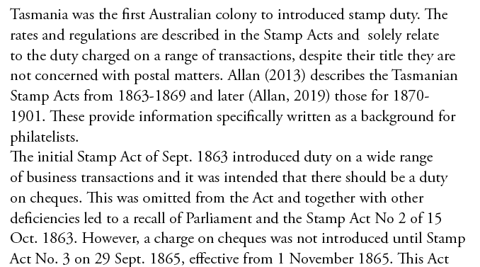
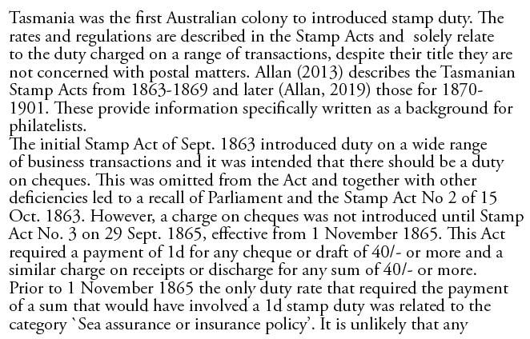
Line height – 1.3 vs 1

Slide 18
Write-up
As well as explaining your exhibit to others, this is where you can pick up marks for knowledge and research
For formal exhibits – write-up focuses on aspects of that class
Include information not obvious to the viewer
Two types of write-up
Technical descriptions of philatelic items
Story line (use a different font )
Headings on every page – important!
Short and simple. Any abbreviations or technical terms, (EG Rarity Ratings) explain in the Title Page

Slide 19
Title or Introductory Page
The reader should know at the start exactly what they are going to see (Scope), where to find the various sections, a little RELEVANT background but not too much and how the exhibit is organised

Slide 20
Title or Introductory Page
Most important page, placed as page 1 of the exhibit
Title of the Exhibit
Scope of the exhibit eg, dates from – to, or geographical area or the Topic or theme as precisely as possible
Plan of the exhibit -the main sections and what page are they on.
Conventions used. EG fonts for technical descriptions vs font of subject descriptions, how rarity is marked eg coloured border
Any info about Rarity and key references, if any
An attractive item to draw the eye – not essential, and in a competitive exhibit this will NOT be Judged

Slide 21
Preparing your Exhibit for an Exhibtion
Your exhibit will be looked after and mounted by others. Certain information is needed to ensure security and manage the process
Put your Name and page number on the back of every sheet
Store in envelopes – one per frame ( C3 envelope measures 458mm x 324mm)
You will be a cover sheet for your exhibit envelopes– one per frame
Bin Room process
Exhibit and Frame numbers allocated
Lodge at the appointed time, collect at the appointed time
Receipt issued - keep this in order to collect
Strict controls are in place to ensure all exhibits are correctly de-mounted and returned to the correct owner.

Slide 22
Resources
Choosing Paper sizes: https://apf.org.au/exhibiting/exhibiting-sheet-sizes/
Buying Paper, corners, storage boxes and Protectors: https://apf.org.au/store
Writing up your display: - see FIP Postal History Commission – Judging Postal History by Hendrik Mouritsen – section on “Judging what the exhibitor knows about the material presented” https://postalhistory.f-i-p.ch/wp-content/uploads/sites/13/2022/02/SS2-Judging-Criteria-for-PH-May11.pps

Slide 23
Any Questions?
The Presentation is available on line to view or download at
https://www.tps.org.au/making-presentations/

